Slide 1

Coca-cola & AI
Data-Analytics Bootcamp
Ironhack-Tech School

Slide 2

“Artificial intelligence is the foundation for everything we do. We create intelligent experiences. Artificial intelligence is the kernel that powers that experience.”
Greg Chambers, Global Director of Digital Innovation,

Slide 3
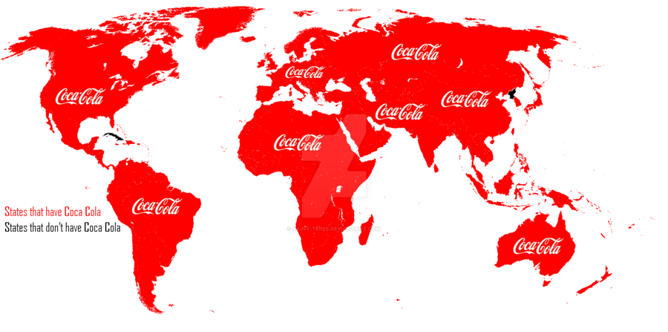
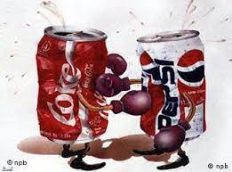
what PROBLEM IS AI HELPING TO SOLVE?
200 COUNTRIES
COMPETITORS
MARKETING PREFERENCES
Flavors
Sugar
Calories

Slide 4
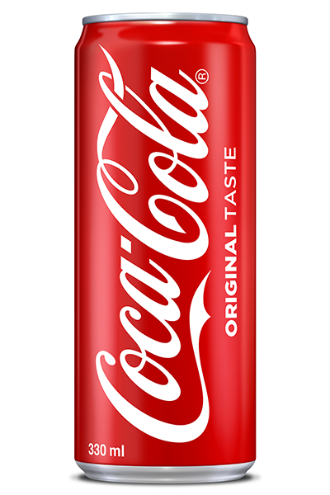
Nª1 in every territory
COMPLEX TAX
COLLECT & ANALYZE DATA
Understand LOCAL PREFERENCES
500 BRANDS & DIFFERENT TASTES
Coca-cola & AI

Slide 5
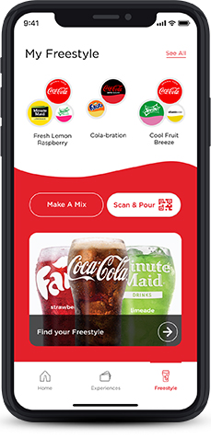
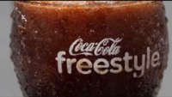
Freestyle soda fountain
Notes:
understandING how the buying habits of its billions of customers varies across the globe.

Slide 6
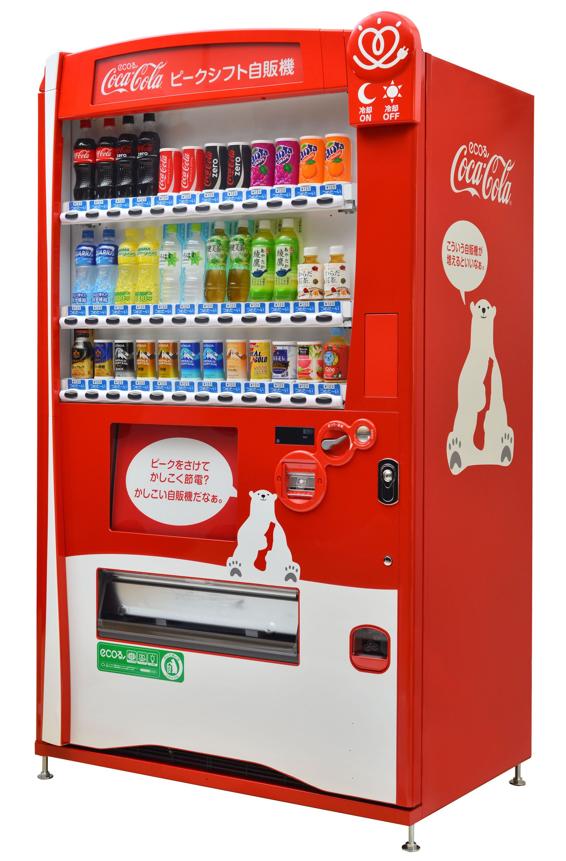

Vending machines with ai
Notes:
understandING how the buying habits of its billions of customers varies across the globe.

Slide 7

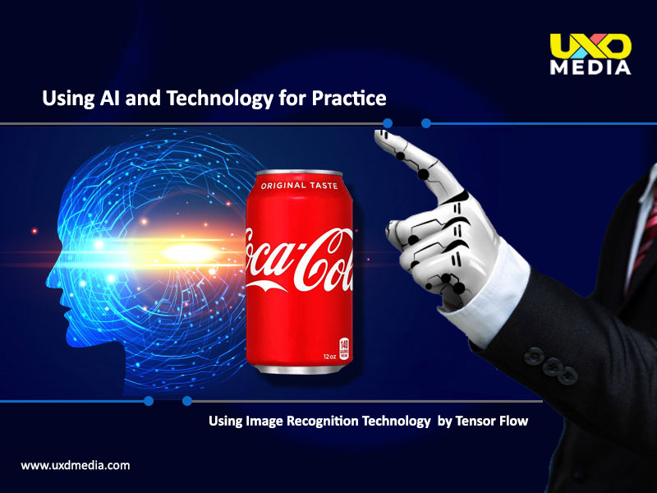
Tensor flow technology
Social Media Marketing
Notes:
understandING how the buying habits of its billions of customers varies across the globe.

Slide 8
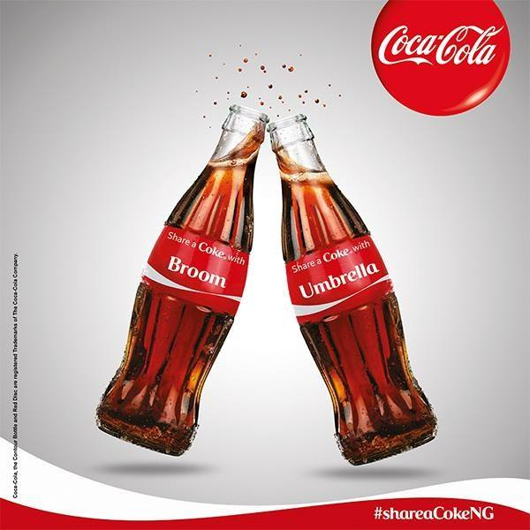
Thank you!

